Slide 1

SECTOR-BASED
TRADE RECOMMENDATION
Exploring The Finance World
SYSTEM
By - Group 9 Anshika Dubey Janhvi Bhangale Prajakta Deokule Tejashree Patil Samruddhi Raut
Mentor Name: Eunice Paulson

Slide 2





Agenda
Key topics discussed in this presentation
Introduction Problem Statement Project Overview Demo
Tech Stack Experience

Slide 3
Stocks
Trade
Stock trading involves buying and selling shares in companies to make money on daily price changes.
S
W
When you invest in a company's stock, it means you own a share in the company that issued the stock.
Nifty 50
Nifty collects the sample of 50 performing and luring stocks on the NSE
(national stock) to determine market trends.
Recommendation System
Trade recommendation system based on user-selected sectors (from Nifty stocks). From the filtered securities - market data takes the top 5 performing stocks based on their growth over the last two weeks.
O
T

Slide 4

Problem Statement
Constructing a trade recommendation system based on User-selected sectors (from Nifty stocks)
Users can select to save any of the recommended stocks with quantity and current market price·
When the user logs in again the user should be able to see the saved stocks and stats.

Slide 5


Scope of The Project
SECTOR-WISE recommendation of top stocks from NIFTY fetched from the Yahoo Finance API
Saving them as per their current market prices and quantity for the future reference
Users can easily see previously saved stocks saved by them.

Slide 6
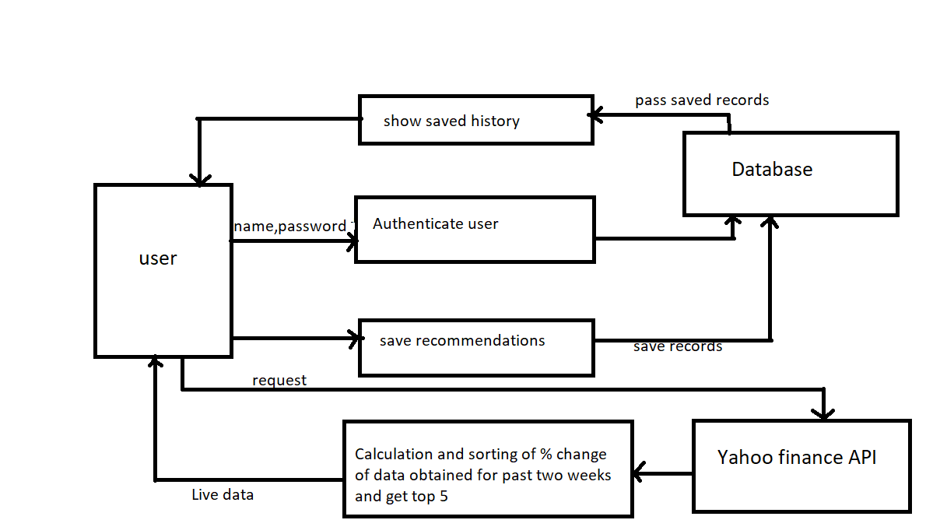
System Architecture

Slide 7
Business Logic
Trade recommendation system takes live market data for specific sector from the Yahoo finance API.
Data for each company is taken over a period of 2 weeks.
To recommend the top performing stocks on the basis of their growth over the last 2 weeks Percentage gain is calculated
Last(today)-Open(2 weeks ago) * 100 Open(2 weeks ago)
Then companies present in the selected sector are sorted based on this percentage gain. Then the user is allowed to save these recommended stocks along with their details.

Slide 8

PROJECT DEMONSTRATION

Slide 9





Frameworks: Angular Springboot
Technologies Used
Database:
MySQL
Web-Service:
Yahoo Finance API
IDE:
Spring Tool Suite Visual Studio Code

Slide 10





“OUR EXPERIENCE"

Slide 11

Any questions
and suggestions!?

Slide 12


